Slide 1
Training and Placement System.
Group : Project Guide:
Hiba Rajguru Rujata Chaudhari.
Nikhil sonawane
Saurabh Kolambkar Co- guide:
Omkar Shelar Anagha aher.

Slide 2
Index:
Introduction
Problem Statement
Purpose
Abstract
Proposed System
Design
Technology Stack
Dependencies
Project Planning

Slide 3
1: Introduction 1.1: Problem Statement
This project is aimed at developing an online application for training and placement department of the college.
The system is an online application that can be accessed throughout the organization and outside as well with proper login provided.
The system can be used as an application for the TPO of the college to manage the student placement.

Slide 4
1.2 : Purpose of The Project
Automation of shortlisting student as per Company Drive.
Proper Management of Training and Placements Activities.
If any modification is required that is to be also done manually. So, to reduce the job required to manage CV’s and the information of various recruiters, a new system is proposed which is processed through computers.

Slide 5
2.Abstract
The 'Training and Placement' is developed for proper management of placements activities in our campus.
This project provides in-detail information of companies and student information at various user levels
Student handbook database is taken as input for resume builder feature.
TPO officer controls major part of information flow in this system.

Slide 6
3. Proposed System
Will provide the security feature by different user panel and admin panel.
Apply job using Register link
Create the report of Company who are registered with our College.
Automation of shortlisting student as per Company Drive.
The reports generations using Data Visualization.

Slide 7
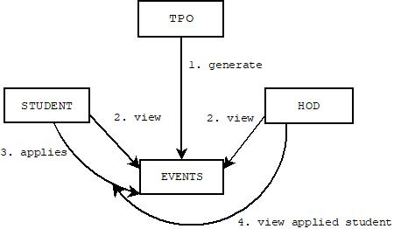
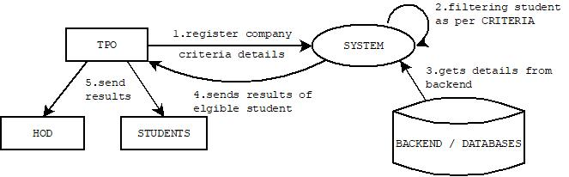
4.Design
Events generations → Home page
Company Registrations and filtering eligible students

Slide 8
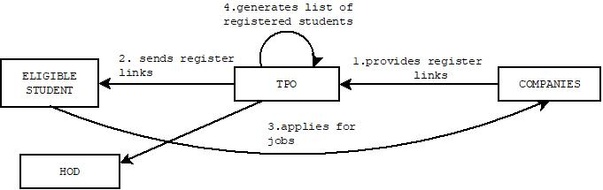
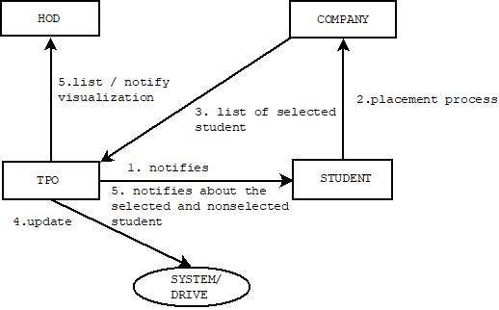
4.Design
Application by Eligible students.
updating Drive by TPO

Slide 9
5.Technology Stack
DESCRIPTION OF FRONT END:
HTML5
CSS3
DESCRIPTION OF BACK END:
MySQL
DESCRIPTION OF SERVER END:
PHP

Slide 10
7.Project Planning
GHANNT CHART
TABLE
START DATE | END DATE | DOCUMENTATION AND REQUIREMENT | DURATION IN DAYS
8/7/18 | 13/8/18 | PREPRATORY PHASE | 6
14/8/18 | 19/8/18 | DOCUMENTATION AND REQUIREMENT | 6
20/8/18 | 27/8/18 | PHASE 1 WORK EFFORT | 6
28/8/18 | 9/9/18 | PHASE 2 WORK EFFORT | 37
9/10/18 | 9/10/18 | SEMESTER 1 FINAL DELIVERY

Slide 11
References
2nd Int'l Conf. on Electrical Engineering and Information & Communication Technology (ICEEICT) 2015 Iahangirnagar University, Dhaka-1342, Bangladesh, 21-23 May 2015
Anjali.V et al, / (IJCSIT) International Journal of Computer Science and Information Technologies, Vol. 7 (2) , 2016, 760-763
Gunderloy, Jorden BPB Publications (2000) - “Mastering SQL Server” 2. Luke Welling and Laura Thomson (5th Edition) - “PHP and MySQL Web Development” 3. Roger S.Pressmen, T. Mc. GH. – Software Engineering (Theoretical Approach) 4. Thereon Willis wrox publications (2000) - “Beginning SQL Server”

Slide 12
Thank you

